Slide 1
Evaluating Language Models

Slide 2
Evaluating Language Models
Does our language model prefer good sentences to bad ones?
Assign higher probability to “real” or “frequently observed” sentences than “ungrammatical” or “rarely observed” sentences?
We train parameters of our model on a training set.
We test the model’s performance on data we haven’t seen.
A test set is an unseen dataset that is different from our training set, totally unused.
An evaluation metric tells us how well our model does on the test set.

Slide 3
Evaluating Language Models
Extrinsic Evaluation
Extrinsic Evaluation of a N-gram language model is to use it in an application and measure how much the application improves.
To compare two language models A and B:
Use each of language model in a task such as spelling corrector, MT system.
Get an accuracy for A and for B
How many misspelled words corrected properly
How many words translated correctly
Compare accuracy for A and B
The model produces the better accuracy is the better model.
Extrinsic evaluation can be time-consuming.

Slide 4
Evaluating Language Models
Intrinsic Evaluation
An intrinsic evaluation metric is one that measures the quality of a model independent of any application.
When a corpus of text is given and to compare two different n-gram models,
Divide the data into training and test sets,
Train the parameters of both models on the training set, and
Compare how well the two trained models fit the test set.
Whichever model assigns a higher probability to the test set
In practice, probability-based metric called perplexity is used instead of raw probability as our metric for evaluating language models.

Slide 5



Evaluating Language Models
Perplexity
The best language model is one that best predicts an unseen test set
– Gives the highest P(testset)
The perplexity of a language model on a test set is the inverse probability of the test set, normalized by the number of words.
Minimizing perplexity is the same as maximizing probability
The perpelexity PP for a test set W=w₁w₂…w_{n} is
PP(W) by chain rule
The perpelexity PP for bigrams: PP(W)

Slide 6
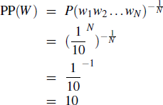
Evaluating Language Models
Perplexity as branching factor
Perplexity can be seen as the weighted average branching factor of a language.
– The branching factor of a language is the number of possible next words that can follow any
word.
Let’s suppose a sentence consisting of random digits
What is the perplexity of this sentence according to a model that assign P=1/10 to each digit?

Slide 7

Evaluating Language Models
Perplexity
Lower perplexity = better model
Training 38 million words, test 1.5 million words, WSJ

Slide 8
Generalization and Zeros
The n-gram model, like many statistical models, is dependent on the training corpus.
the probabilities often encode specific facts about a given training corpus.
N-grams only work well for word prediction if the test corpus looks like the training corpus
In real life, it often doesn’t
We need to train robust models that generalize!
One kind of generalization: Getting rid of Zeros!
Things that don’t ever occur in the training set, but occur in the test set
Zeros: things that don’t ever occur in the training set but do occur in the test set causes problem for two reasons.
First, underestimating the probability of all sorts of words that might occur,
Second, if probability of any word in test set is 0, entire probability of test set is 0.

Slide 9
Unknown Words
We have to deal with words we haven’t seen before, which we call unknown words.
We can model these potential unknown words in the test set by adding a pseudo-word
called <UNK> into our training set too.
One way to handle unknown words is:
Replace words in the training data by <UNK> based on their frequency.
For example we can replace by <UNK> all words that occur fewer than n times in the training set, where n is some small number, or
Equivalently select a vocabulary size V in advance (say 50,000) and choose the top V words by frequency and replace the rest by <UNK>.
Proceed to train the language model as before, treating <UNK> like a regular word.

Slide 10
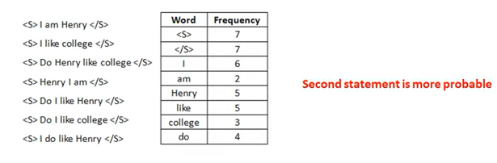

Slide 11
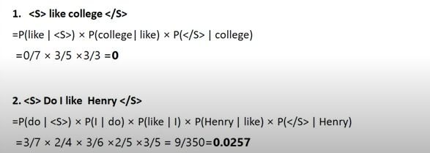

Slide 12
Smoothing
To keep a language model from assigning zero probability to these unseen events, we’ll have to shave off a bit of probability mass from some more frequent events and give it to the events we’ve never seen.
This modification is called smoothing (or discounting).
There are many ways to do smoothing, and some of them are:
Add-1 smoothing (Laplace Smoothing)
Add-k smoothing,
Backoff

Slide 13
Laplace Smoothing
The simplest way to do smoothing is to add one to all the counts, before we normalize them into probabilities.
– All the counts that used to be zero will now have a count of 1, the counts of 1 will be 2, and so on.
This algorithm is called Laplace smoothing (Add-1 Smoothing).
We pretend that we saw each word one more time than we did, and we just add one to
all the counts!,

Slide 14
Laplace Smoothing ( Add-1 Smoothing )
Laplace Smoothing for Unigrams:
The unsmoothed maximum likelihood estimate of the unigram probability of the word
w_{i} is its count c_{i} normalized by the total number of word tokens N:
P(w_{i}) = c_{i} / N
Laplace smoothing adds one to each count. Since there are V words in the vocabulary and each one was incremented, we also need to adjust the denominator to take into account the extra V observations.
P_{Laplace}(w_{i}) = (c_{i} + 1) / (N + V)

Slide 15

Laplace Smoothing for Bigrams
The normal bigram probabilities are computed by normalizing each bigram counts by the unigram count:
Add-one smoothed bigram probabilities:

Slide 16
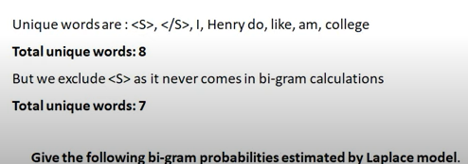

Slide 17
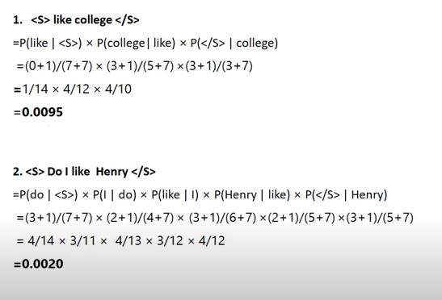

Slide 18

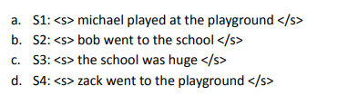


Slide 19
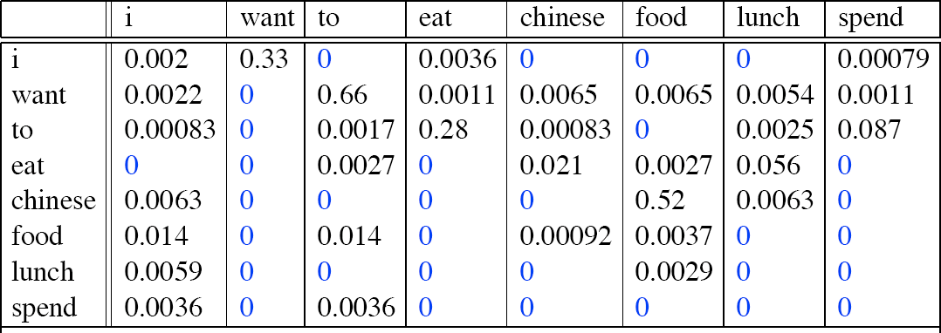

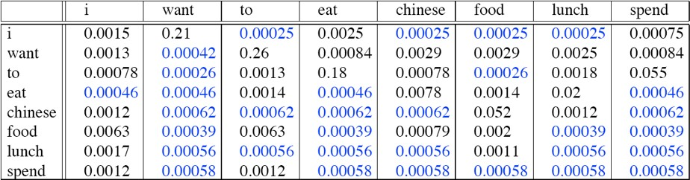
Laplace-smoothed Bigrams
Corpus: Berkeley Restaurant Project Sentences

Slide 20
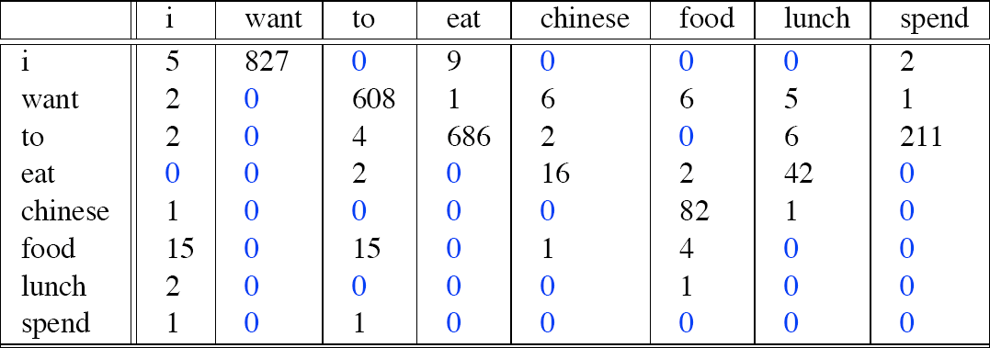


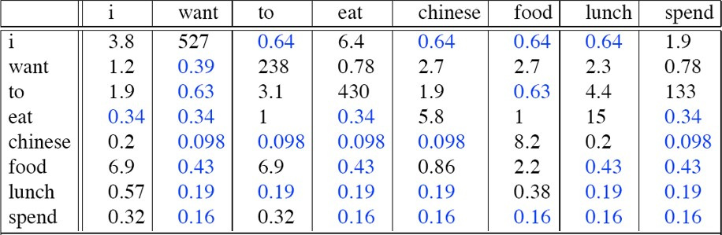
Laplace-smoothed Bigrams
Corpus: Berkeley Restaurant Project Sentences: Adjusted counts

Slide 21

Add-k Smoothing
Add-one smoothing has made a very big change to the counts.
C(want to) changed from 608 to 238!
P(to|want) decreases from .66 in the unsmoothed case to .26 in the smoothed case.
Looking at discount d shows us how counts for each prefix word have been reduced;
discount for bigram want to is .39, while discount for Chinese food is .10, a factor of 10
The sharp change in counts and probabilities occurs because too much probability
mass is moved to all the zeros.
One alternative to add-one smoothing is to move a bit less of the probability mass from the seen to the unseen events.
Instead of adding 1 to each count, we add a fractional count k (.5? .05? .01?).
This algorithm is called add-k smoothing.

